Slide 1


Resistance
Is your work well presented?
Lesson Objectives
1. Describe what is meant by resistance and how resistance can be measured.
2. Explain how increasing the resistance in a circuit will affect the current flowing through the circuit.
3. Use the equation potential difference = current x resistance (V=IR).

Slide 2

Achieving Objective 1 - Describe what is meant by resistance and how resistance can be measured.
What is resistance?
Resistance is a measure of how hard it is for a current to flow through a component in a circuit. The unit of resistance (R) is the Ohm, (Ω).
Resistors are added into a circuit to reduce the amount of current flowing. The bigger the value of resistance the lower the current.
Components such as bulbs have resistance. When more bulbs are added to a series circuit, resistance increases causing the current to decrease.
How do we measure resistance in a circuit? Think about the meaning of resistance.
Review
What have we found out?
Is your work well presented?

Slide 3
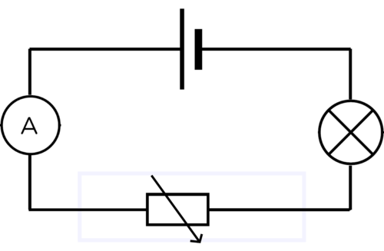
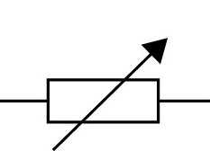
Resistance investigation.
Achieving Objective 2 - Explain how increasing the resistance in a circuit will affect the current flowing through the circuit.
Set up this simple circuit.
What happens to the current as the resistance is changed?
Why does the resistance increase with more wire used in the variable resistor?
Electrical resistance in a metal is caused by electrons colliding with atoms. Longer wire has more atoms.
Collison's cause the atoms to vibrate. The more the atoms vibrate the more collisions. This increases the resistance.
Review
What have we found out?
Is your work well presented?

Slide 4
Achieving Objective 3 - Use the equation potential difference = current x resistance (V=IR).
Calculating resistance, current or P.D.
Resistance, current and voltage (potential difference) are related by this equation:
Potential difference = current x resistance (V= I R)
Volts (V) Ampere (A) Ohm, (Ω).
Example. What potential difference causes a current of 3A to flow through an 80Ω resistor?
V = 3A x 80 Ω
V = 240V
What potential difference causes a current of 6A to flow through an 30Ω resistor?
What potential difference causes a current of 15A to flow through an 16Ω resistor?
V = 180V
V = 240V
Review
What have we found out?
Is your work well presented?

Slide 5
Achieving Objective 3 - Use the equation potential difference = current x resistance (V=IR).
Calculating resistance, current or P.D.
potential difference (V) = current (I) x resistance (R)
How can we rearrange this equation to find the current?
Calculate the current when a potential difference of 240V is passing through a wire with resistance 30Ω?
Calculate the current when a potential difference of 20kV is passing through a wire with resistance 800Ω?
A potential difference of 240V is passing through a wire with resistance 2kΩ?
I = 8 A
I = 25 A
I = 0.12 A
Review
What have we found out?
Is your work well presented?

Slide 6
Achieving Objective 3 - Use the equation potential difference = current x resistance (V=IR).
Calculating resistance, current or P.D.
potential difference (V) = current (I) x resistance (R)
How can we rearrange this equation to find the resistance?
Calculate the resistance when a potential difference of 40kV with a current of 888A?
Calculate the resistance when a potential difference of 2V with a current of 8A?
Calculate the resistance when a potential difference of 160V with a current of 0.8A?
R = 45Ω
R = 0.25Ω
R = 200Ω
Review
What have we found out?
Is your work well presented?

